Slide 1
Constrained procedural generation

Slide 2
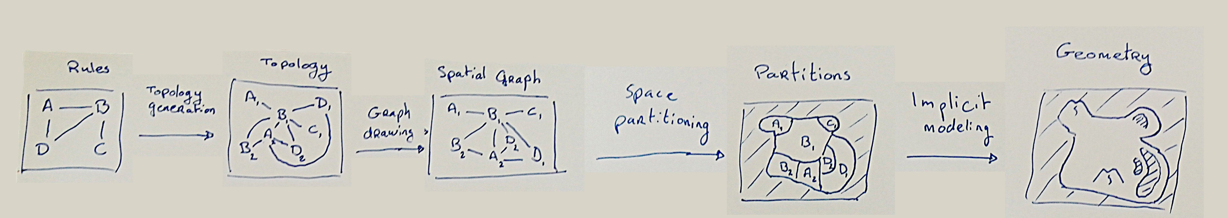
Objective
Generating a 3D scene taking into account constraints between elements

Slide 3
Motivations
Using user-defined rules to generate a terrain
Explainability at each step of the process
Intermediate results for user refinements
Low memory footprint
Probably fast?

Slide 4
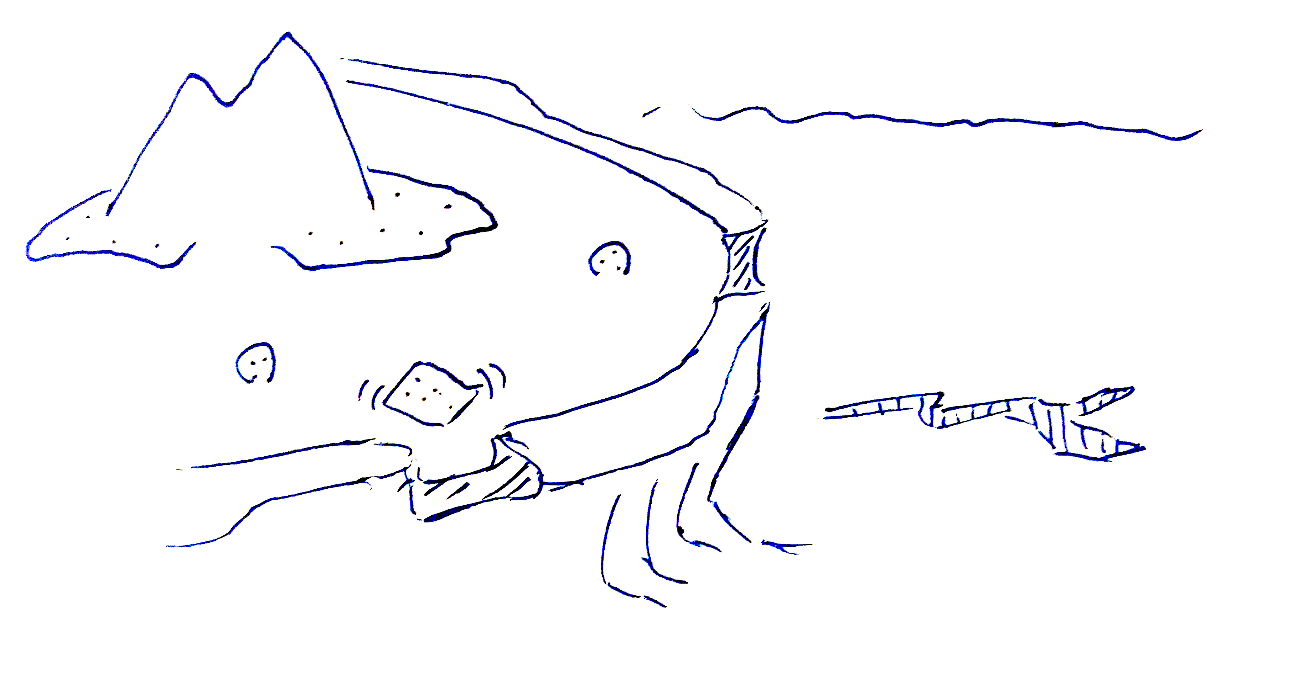
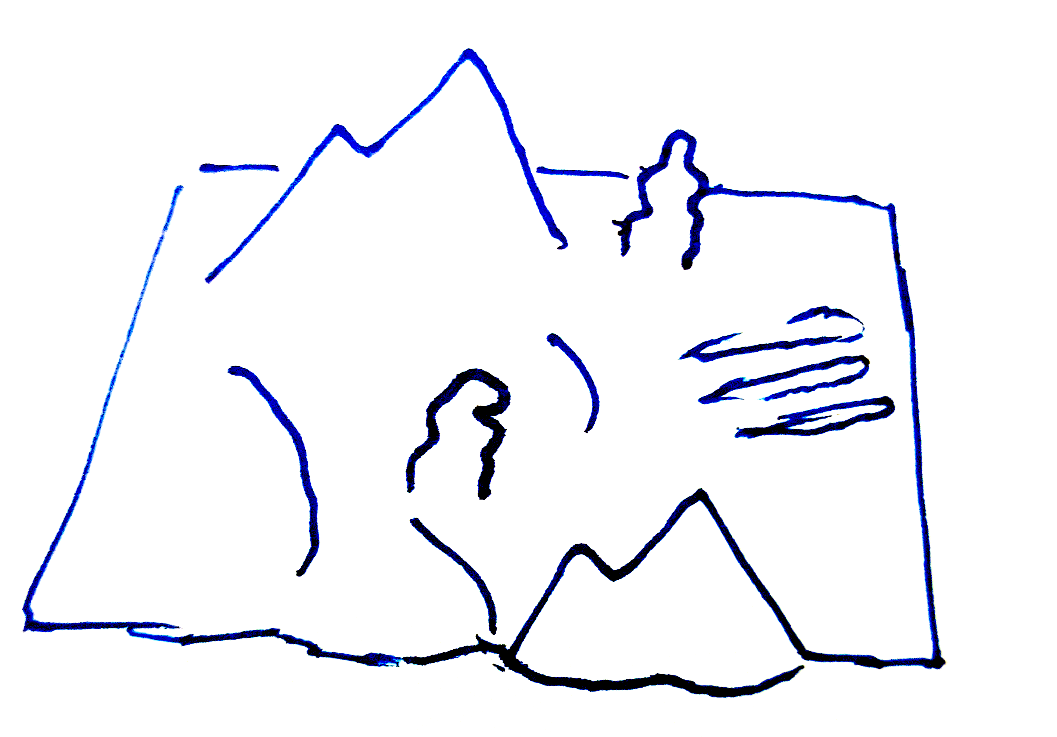
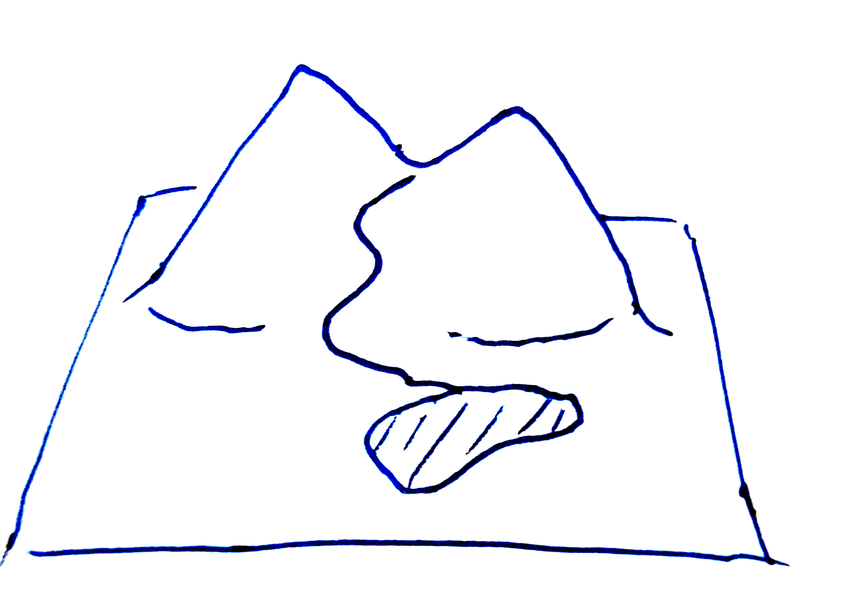
Application examples
Creation of coral islands
Creation of desertic scenes
Creation of mountainious scenes

Slide 5
Inputs / Outputs
Inputs:
A set of rules defined as a graph, describing how elements can be placed w.r.t. each other
Intermediates:
Terrain defined by a graph of instanced elements
A spatial partitioning of the elements
A CSG tree representing the terrain
Outputs:
The geometry of the generated terrain defined by multiple implicit volumes

Slide 6
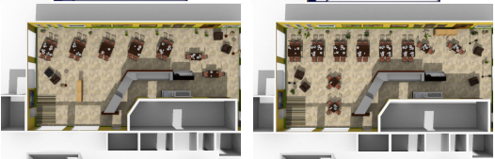

Related works
[YYW*12] Yi-Ting Yeh, Lingfeng Yang, Matthew Watson, Noah D. Goodman, and Pat Hanrahan. 2012. Synthesizing open worlds with constraints using locally annealed reversible jump MCMC. ACM Trans. Graph. 31, 4, Article 56 (July 2012), 11 pages. https://doi.org/10.1145/2185520.2185552
[PGK*21] Wamiq Para, Paul Guerrero, Tom Kelly, Leonidas J. Guibas, Peter Wonka. Generative layout modeling using constraint graphs. Proceedings of the IEEE/CVF International Conference on Computer Vision. 2021. https://doi.org/10.48550/arXiv.2011.13417

Slide 7
Positioning
[YYW*12]
They use mesh instances to place elements in the scene, we have implicit volumes varying in shape
[PGK*21]
They generate “blocks” layout, we should extend it to a shape-free layout

Slide 8
Contributions
Complete pipeline for rule-based terrain generation
Multi-stage user refinement

Slide 9
The plan
Going from bottom to top:
Modeling from partition
Partitioning from spatial graph
Spatialization of topological graph
Topology generation from adjacency rules
Only after, see for improvements (real 3D, materials, interactions between objects, …)

Slide 10
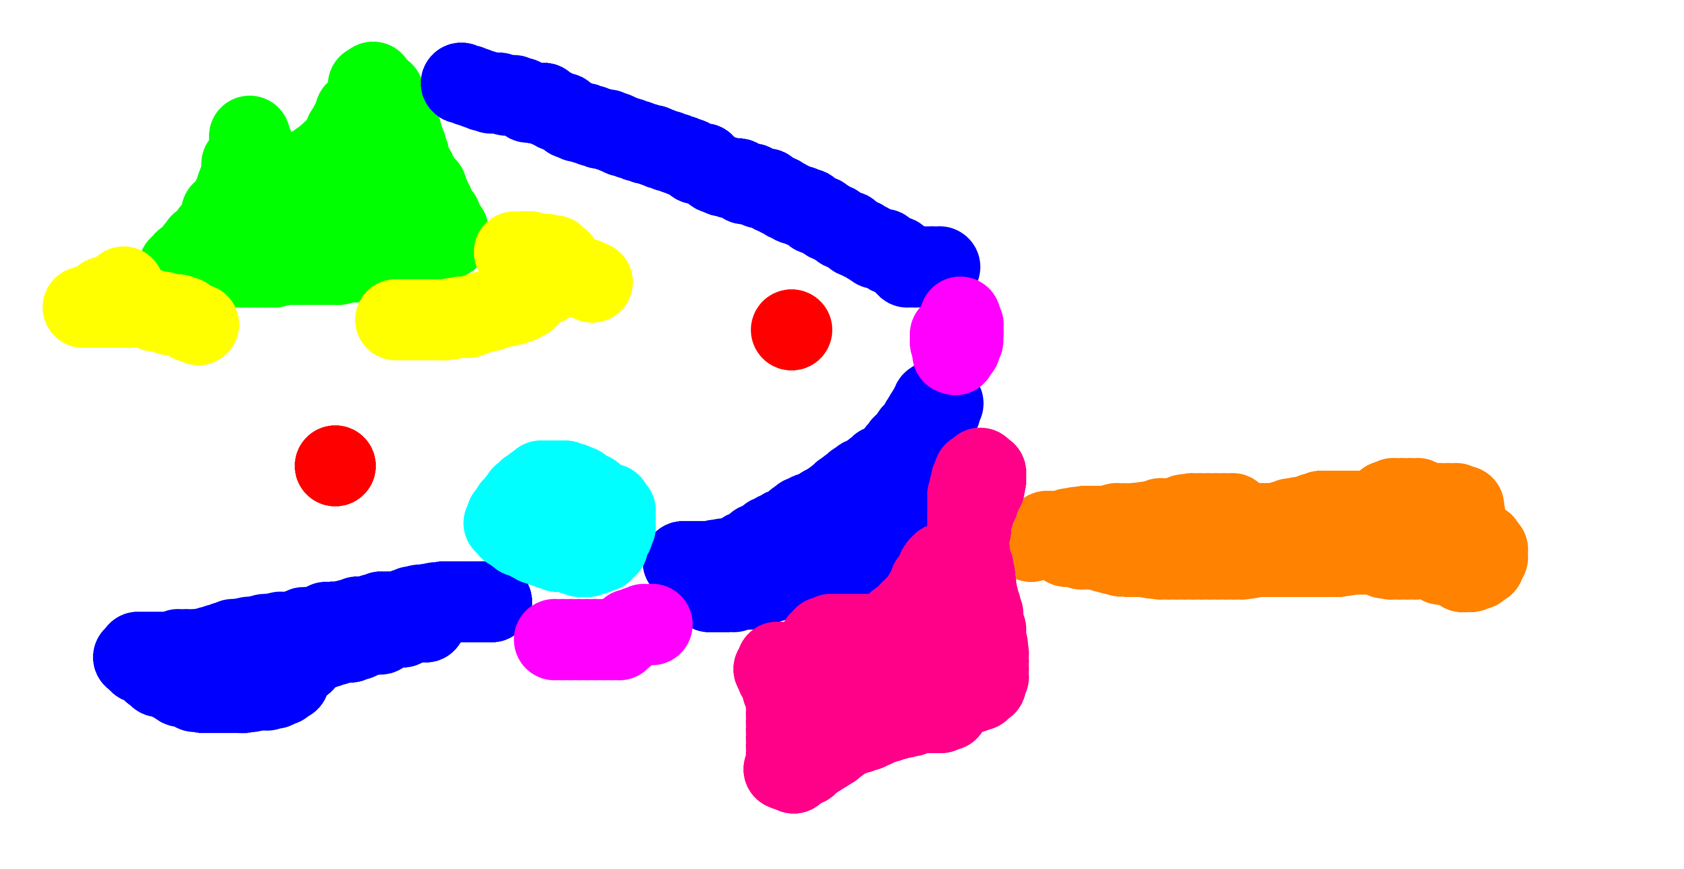
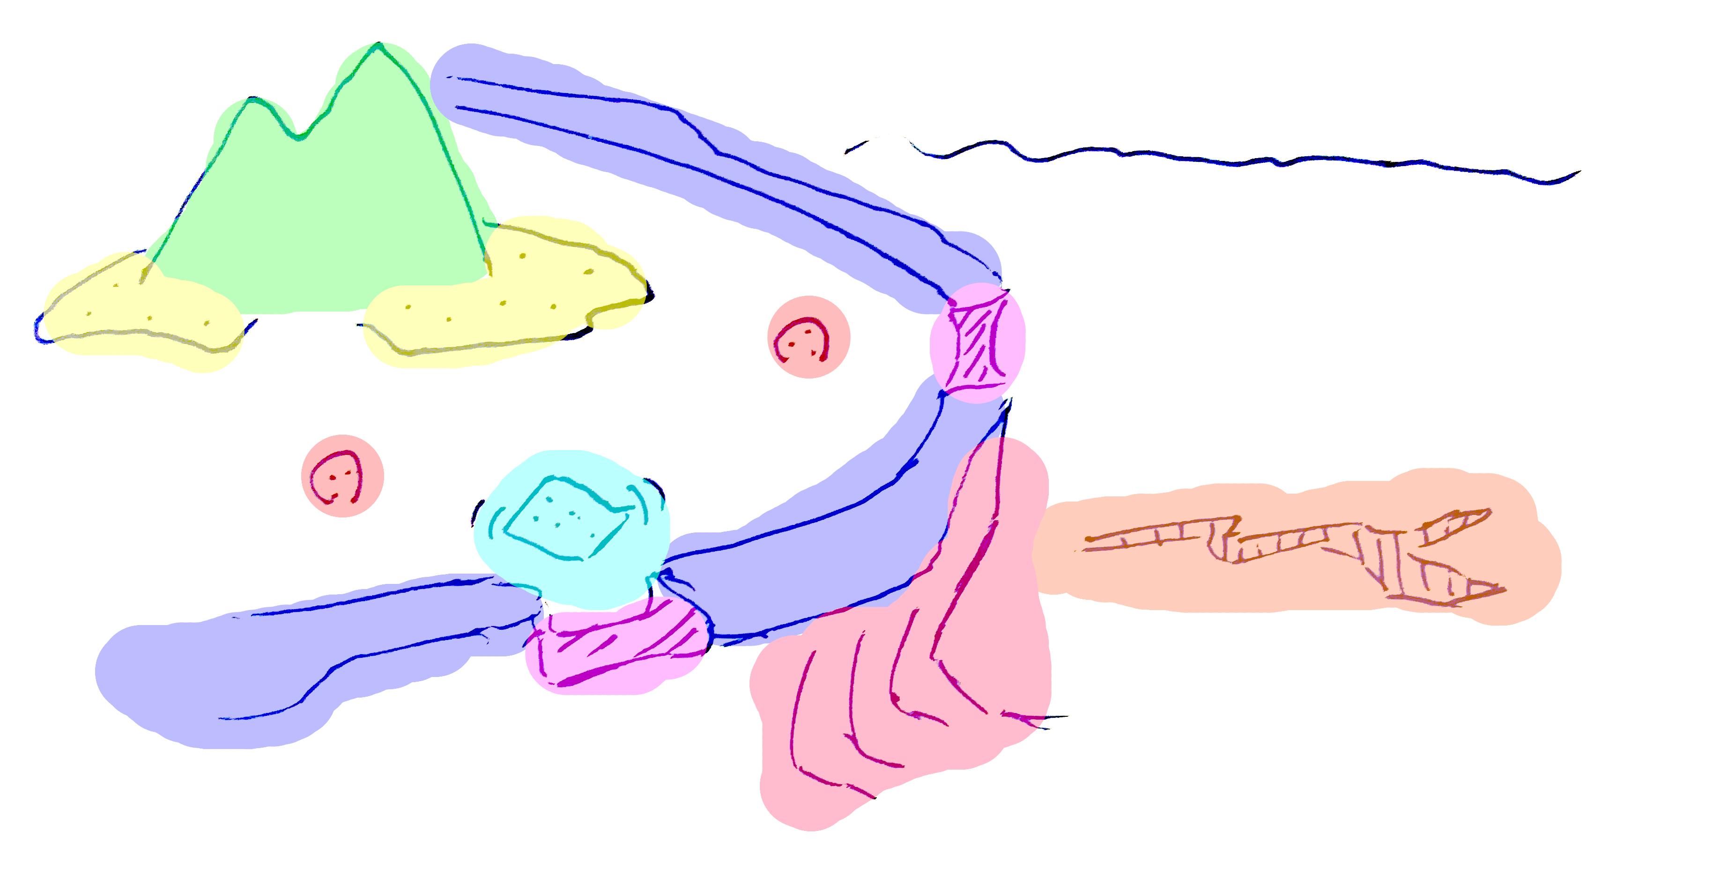
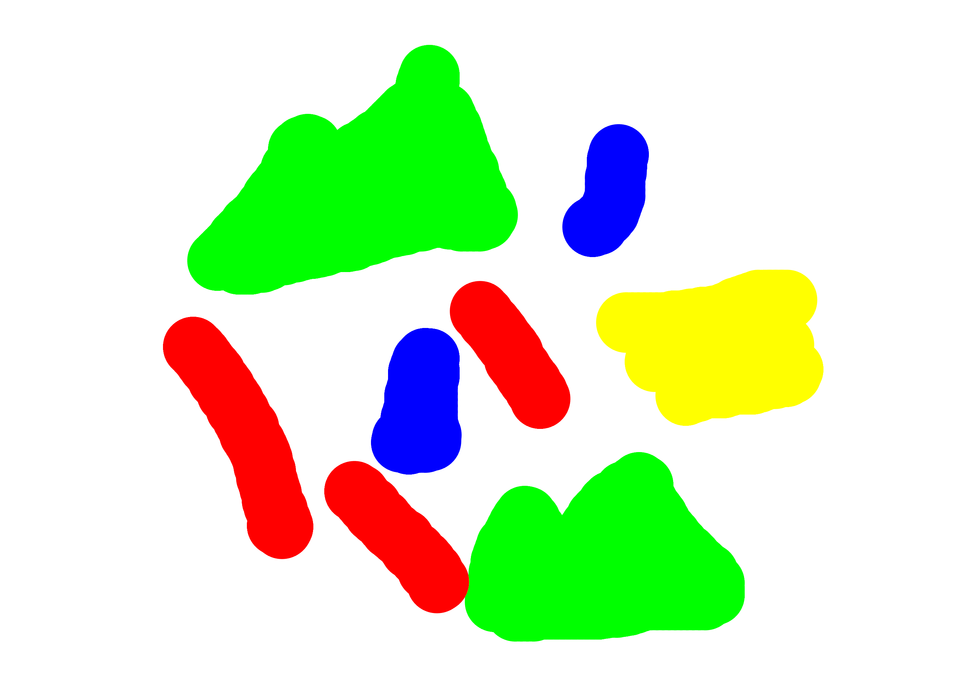
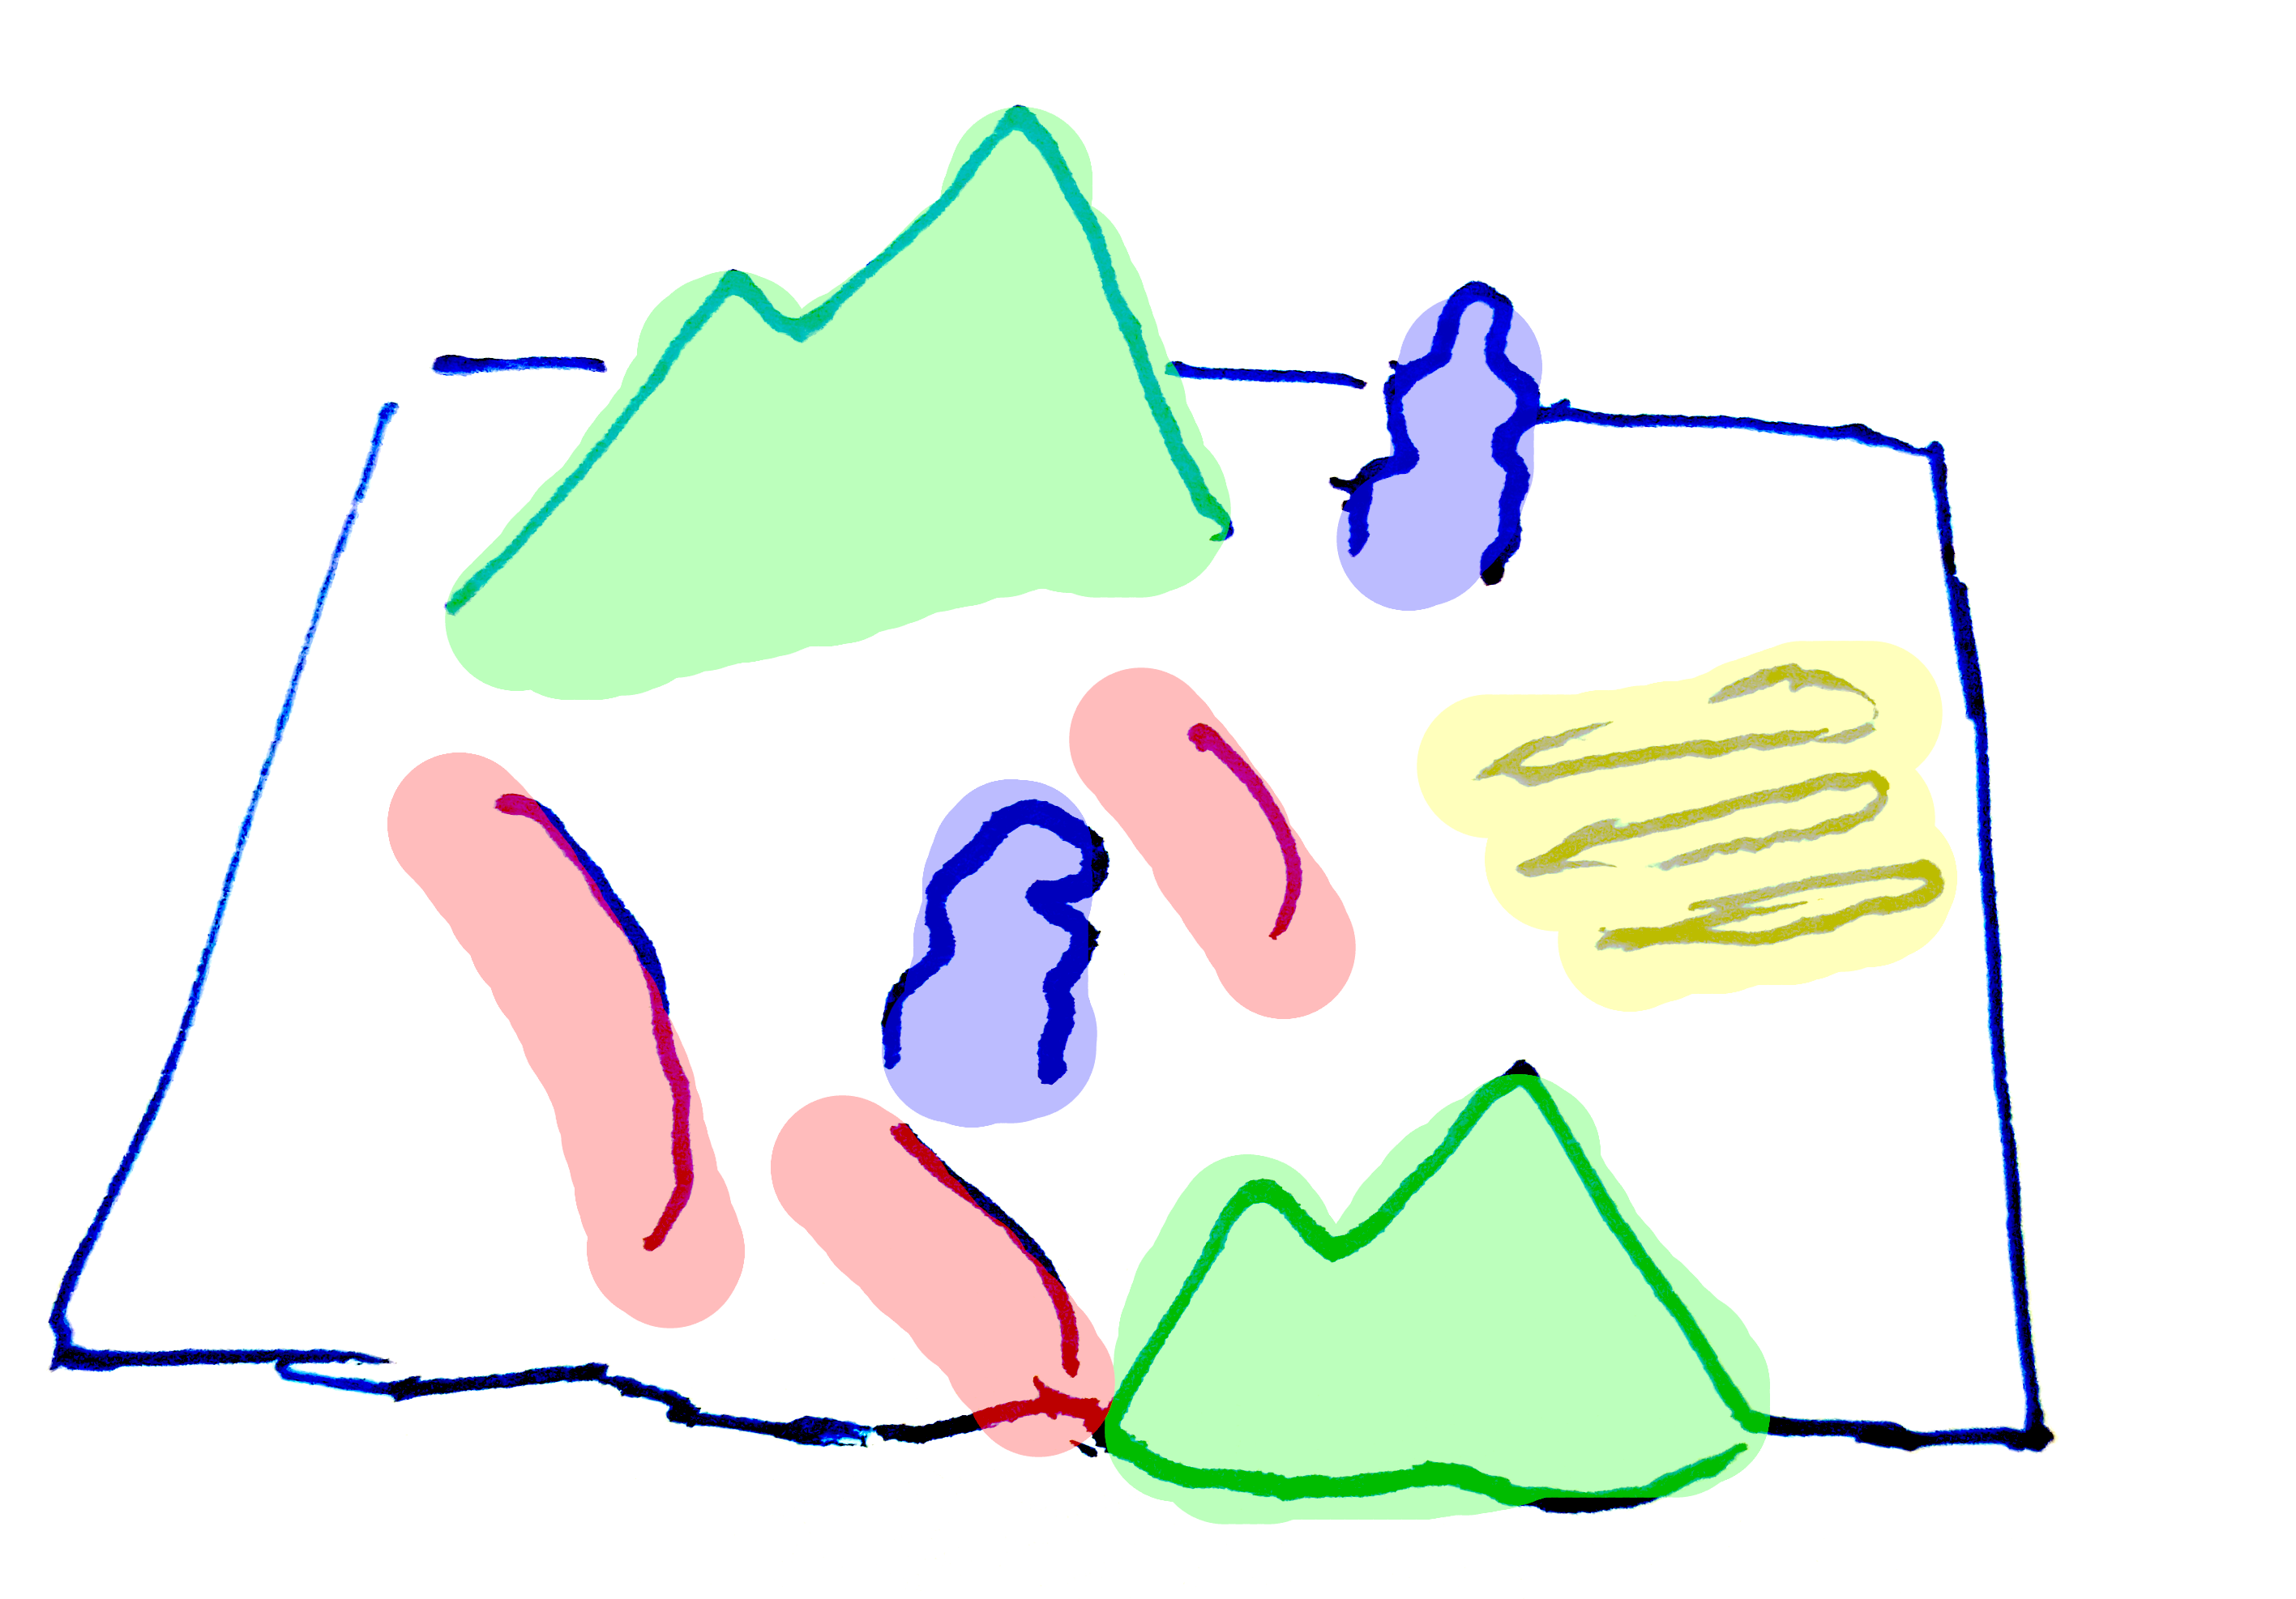
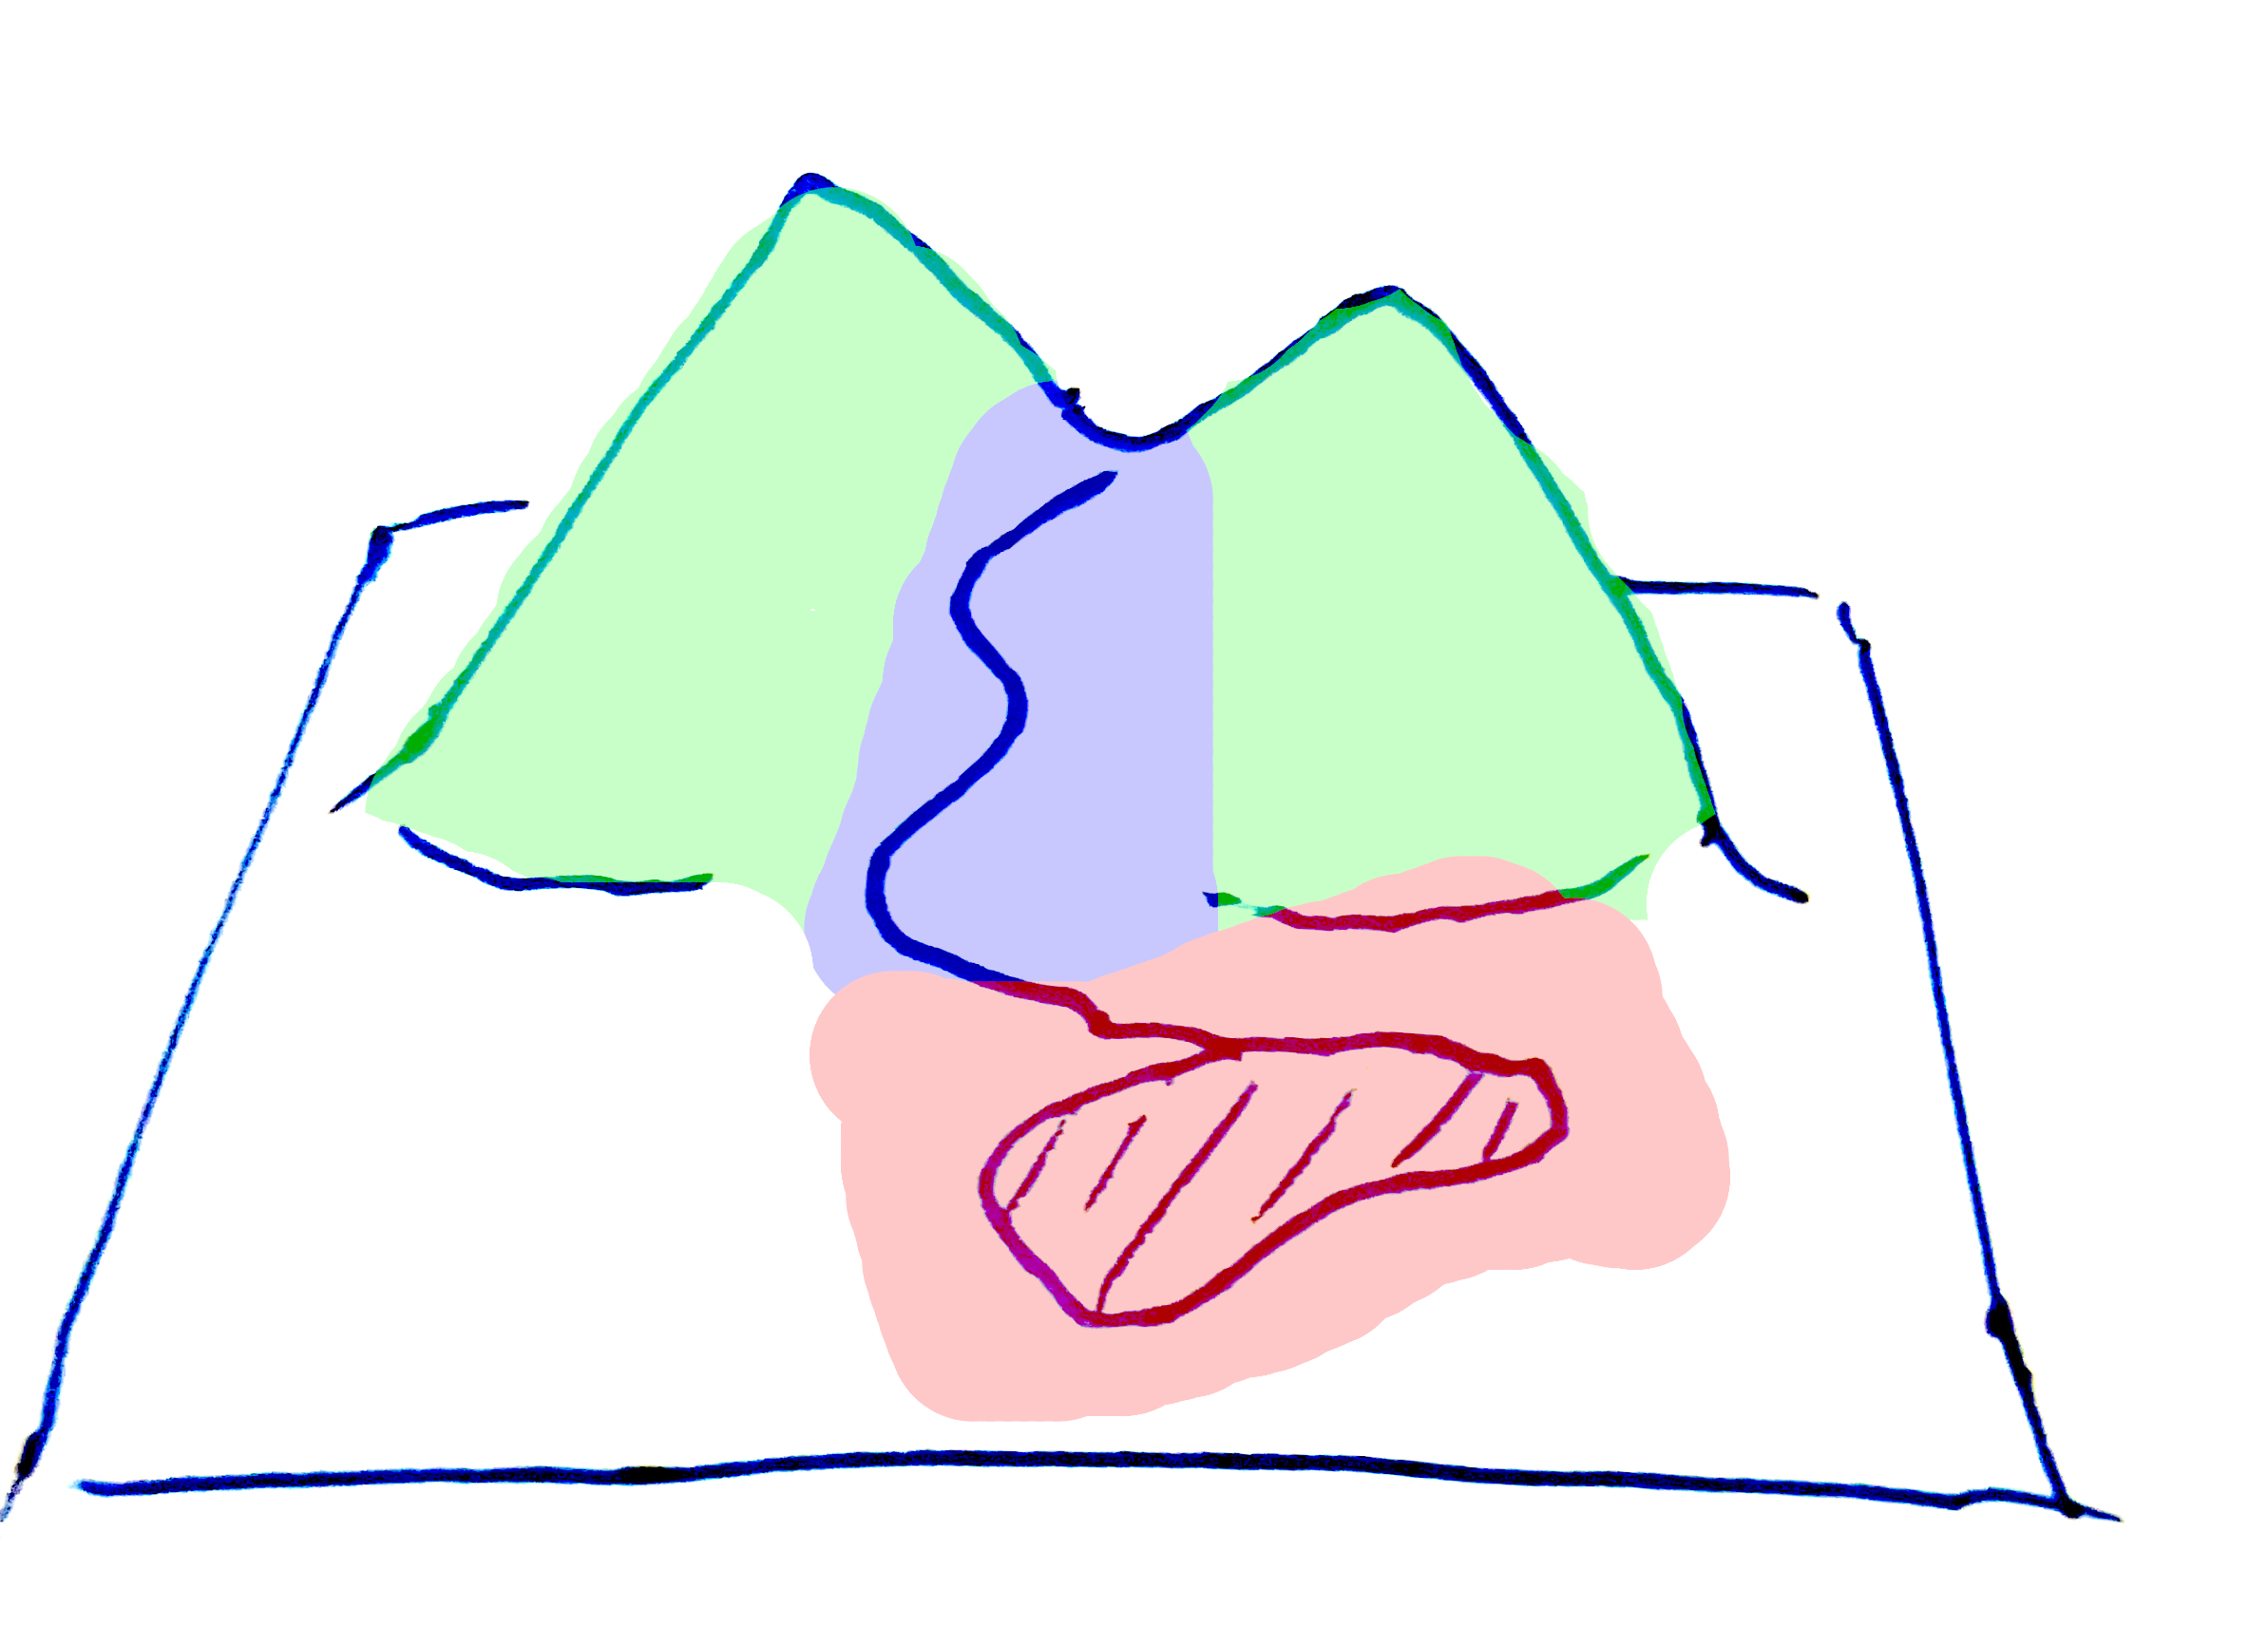
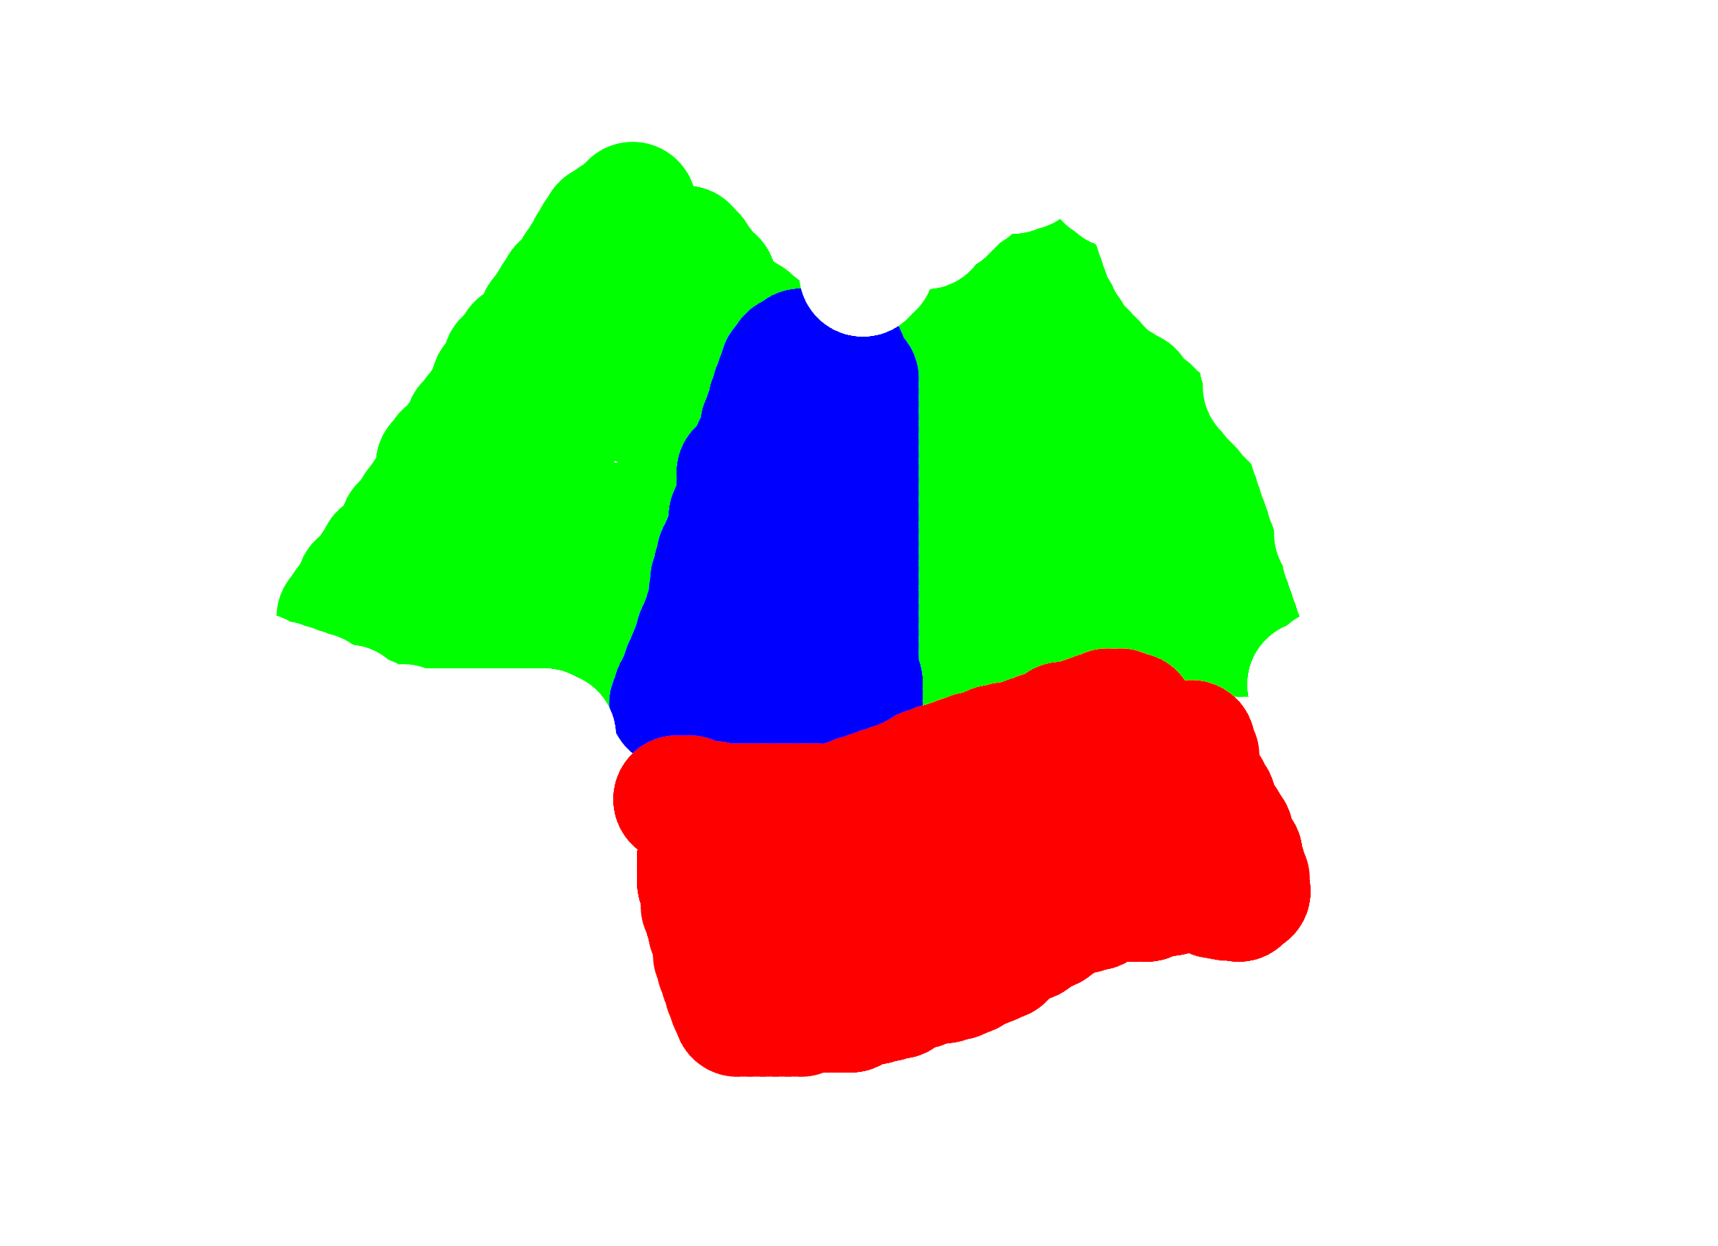
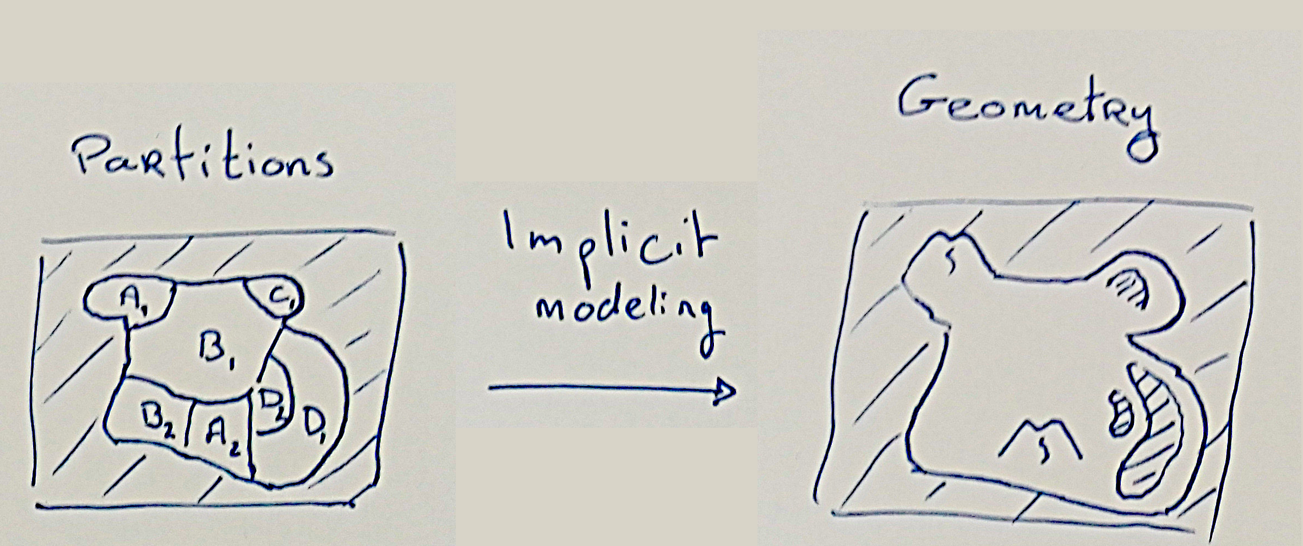
Modeling from partitions
Objective:
Defining 3 scenes to create
Island reef
Desertic landscape
Mountainous scene
Construction of a CSG tree
Q: How to define the primitive in a variable area?
Distorsions? Masking? …

Slide 11
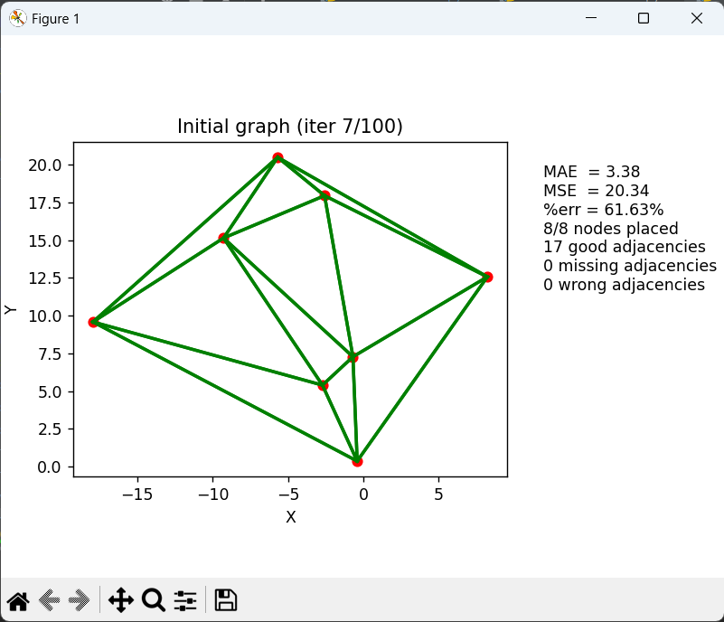
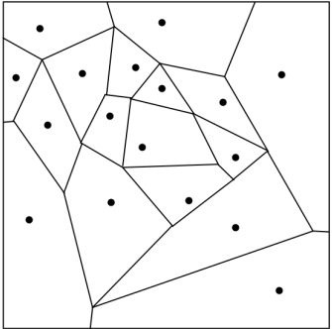
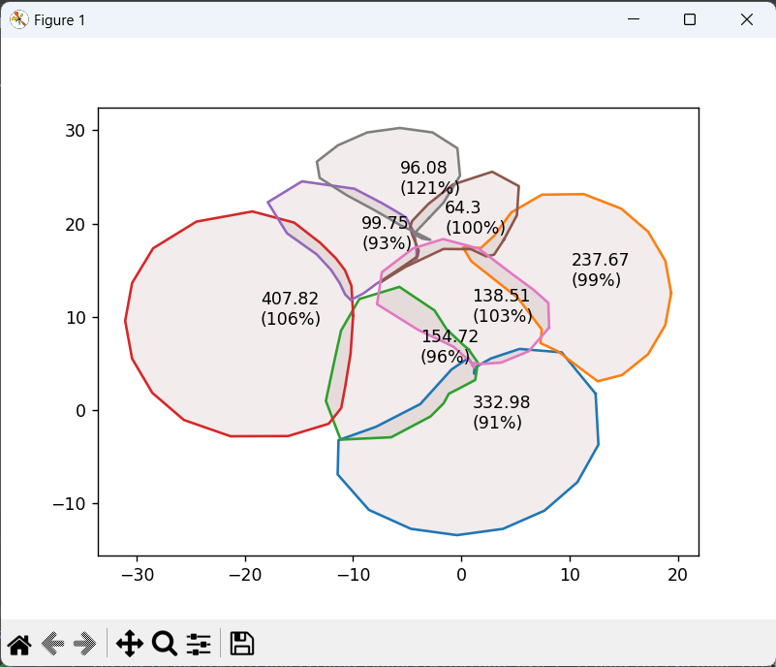
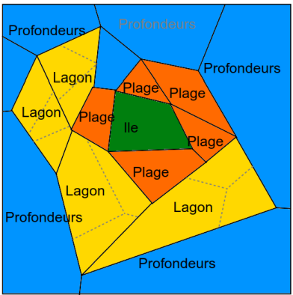
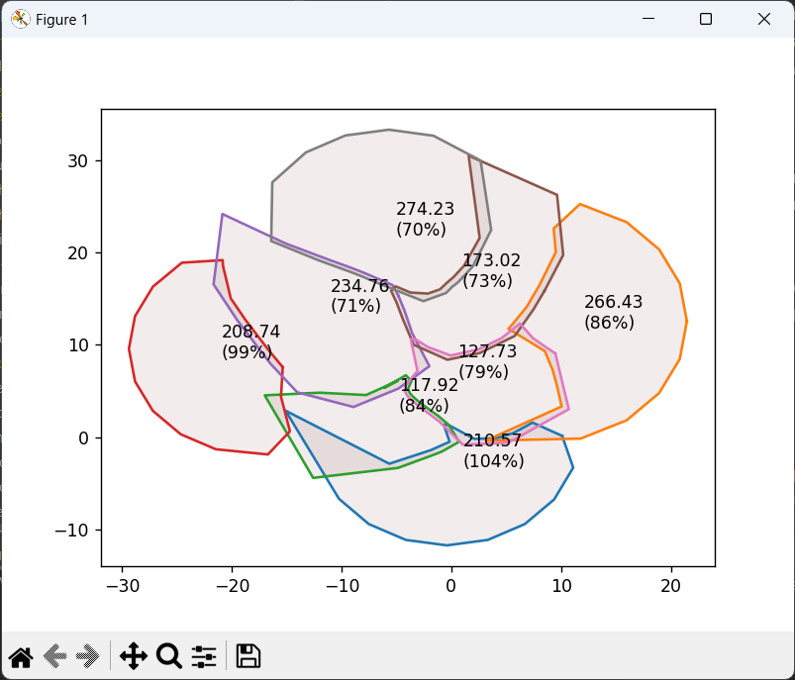
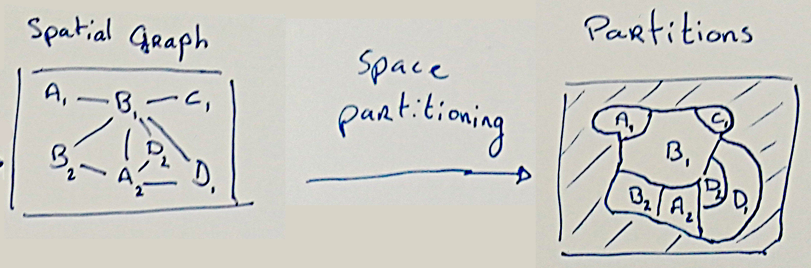
Partitioning from spatial graph
The tough part…
Defining a region for each node
Keep the topology during the spatialization

Slide 12
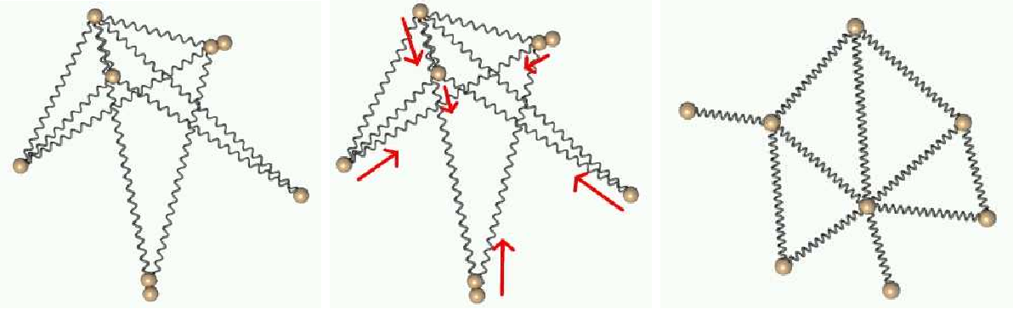
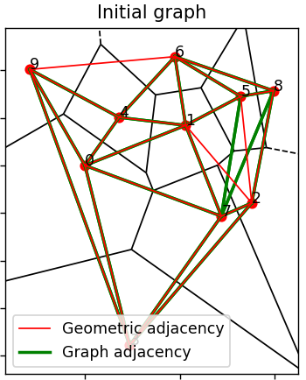
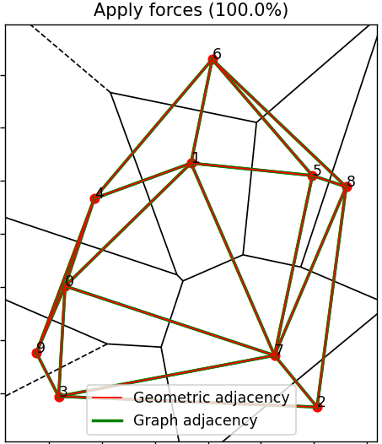
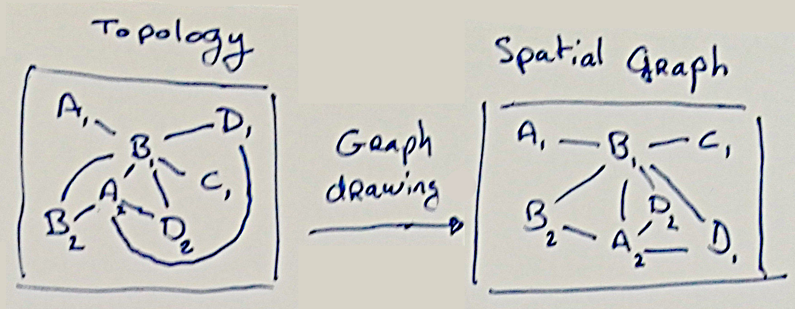
Spatialization of topological graph
The problem of drawing planar graphs
Looking for “good enough” drawings
= Finding an heuristic that fits the need + optimization task

Slide 13
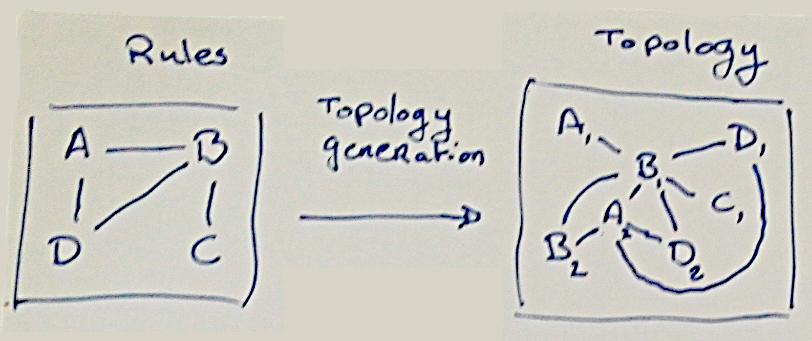
Topology generation from adjacency rules
Definition of «rules»
Usage of graph grammar

Slide 14
Additional improvements
Defining materials in the construction blocks
Adding properties to each node, interacting with each other
A multi-level definition of the networks
Real 3D…

Slide 15
Current state
Topology generation (Graph grammar) | Not started, but using simple graph grammar / graph rewiting seems good enough
Spatialization of topological graph (Network drawing) | Done using spring systems
Spatial partitioning | Started, multiple ideas have been tested without finding a perfect one (Voronoi diagram, WFC, iterative shape refinement)
Modeling from partition (Implicit modeling, mesh generation) | Mostly done, but missing the «variable area» part

